Slide 1
Obstacle Avoidance Using Arduino and Ultrasonic Sensor
PRIYANSHI SINGH
B.Tech VII SEM
Roll No: 15
Branch: Electronics and Communication

Slide 2
Introduction
The obstacle avoidance robotics is used for detecting obstacles and avoiding the collision.
The design of obstacle avoidance robot requires the integration of many sensors according to their task.
Ultrasonic sensor is most suitable for obstacle detection and it is of low cost and has high ranging capability.
The project is designed to build an obstacle avoidance robotic vehicle using ultrasonic sensors for its movement.
An Arduino uno is used to achieve the desired operation.

Slide 3
A robot is a machine that can perform task automatically. Robotics is generally a combination of computational intelligence and physical machines (motors). Computational intelligence involves the programmed instructions.
The project proposes robotic vehicle that has an intelligence built in it such that it guides itself whenever an obstacle comes ahead of it. This robotic vehicle is built, using an Arduino uno. An ultrasonic sensor is used to detect any obstacle ahead of it and sends a command to the Arduino.
In today’s world robotics is a fast growing and interesting field. Autonomous Intelligent Robots are robots that can perform desired tasks in unstructured environments without continuous human guidance. The obstacle detection is primary requirement of this autonomous robot. The robot gets the information from surrounding area through mounted sensors on the robot.

Slide 4
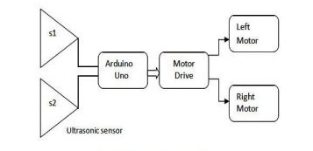
Block Diagram

Slide 5
Hardware requirements
• Arduino Uno
• Ultrasonic sensor (HC SR04)
• Arduino L293D motor driver shield
• DC Motor
Servo motor
• Power Supply

Slide 6
Arduino UNO
• Microcontroller board based on the ATmega328P.
• 14 digital input/output pins (of which 6 can be used as PWM outputs)
• 6 Analog inputs.
• 16 MHz quartz crystal
• A power jack
• Connect it to a computer with a USB cable or power it with a AC-to-DC adapter or battery to get started.

Slide 7
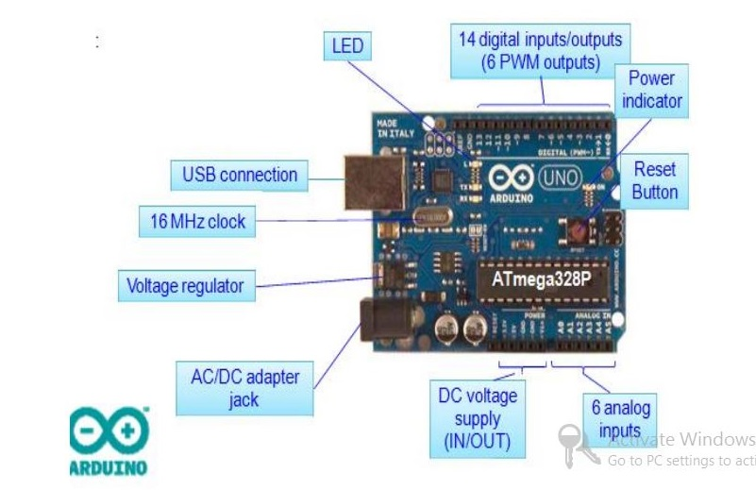
Arduino UNO Board

Slide 8
Ultrasonic Sensor
The ultrasonic sensor is used for obstacle detection.
Ultrasonic sensor transmits the ultrasonic waves from its sensor head and again receives the ultrasonic waves reflected from an object.
There are many application use ultrasonic sensors like instruction alarm system, automatic door openers etc. The ultrasonic sensor is very compact and has a very high performance.
It has both the transmitter and receiver. It consists of four pins Vcc pin to offer a 5V supply to the sensor, trigger pin give a TTL pulses (15us), echo pin to get the output from the sensor and ground pin.

Slide 9
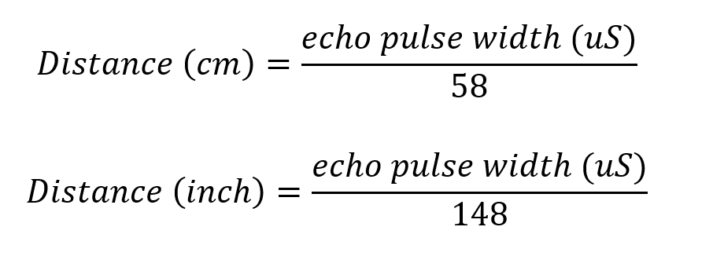
Ultrasonic sensor working
Typically, a microcontroller is used for communication with an ultrasonic sensor.
To begin measuring the distance, the microcontroller sends a trigger signal to the ultrasonic sensor. The duty cycle of this trigger signal is 10μS for the HC-SR04 ultrasonic sensor.
When triggered, the ultrasonic sensor generates eight acoustic (ultrasonic) wave bursts and initiates a time counter. As soon as the reflected (echo) signal is received, the timer stops.
The output of the ultrasonic sensor is a high pulse with the same duration as the time difference between transmitted ultrasonic bursts and the received echo signal. The microcontroller interprets the time signal into distance using the following functions:

Slide 10
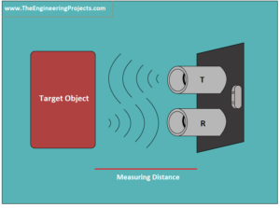
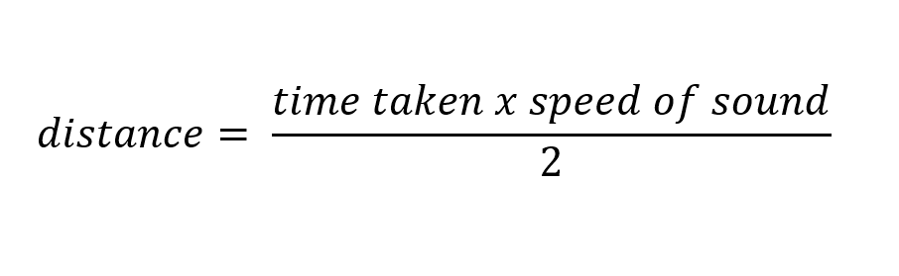
Theoretically, the distance can be calculated using the TRD (time/rate/distance) measurement formula. Since the calculated distance is the distance travelled from the ultrasonic transducer to the object—and back to the transducer—it is a two-way trip. By dividing this distance by 2, you can determine the actual distance from the transducer to the object. Ultrasonic waves travel at the speed of sound (343 m/s at 20°C). The distance between the object and the sensor is half of the distance travelled by the sound wave. The following equation calculates the distance to an object placed in front of an ultrasonic sensor:

Slide 11
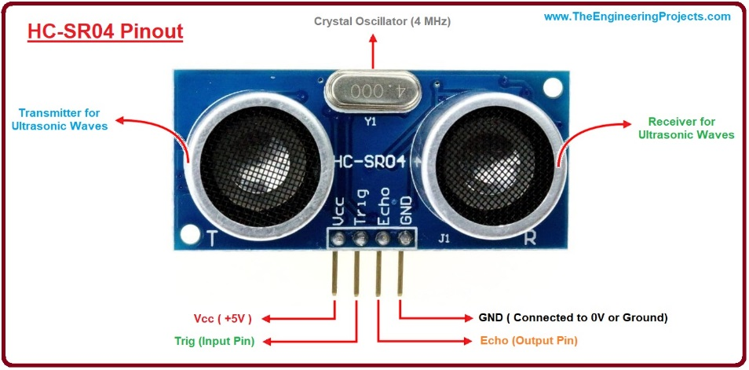
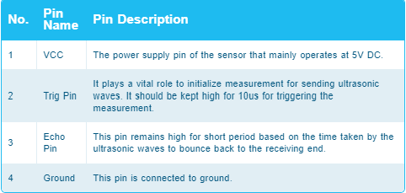
HC-SR04 Ultrasonic sensor

Slide 12
Arduino L293D motor driver shield.
We can’t connect DC motor, Stepper motor, Servo motor to microcontrollers or controller board such as Arduino directly in order to control them since they possibly need more current than a microcontroller can drive so we need drivers.
The driver is an interface circuit between the motor and controlling unit to facilitate driving. Drives come in many different types.
L293D shield is a driver board based on L293 IC, which can drive 4 DC motors and 2 stepper or Servo motors at the same time.
Each channel of this module has the maximum current of 1.2A and doesn’t work if the voltage is more than 25v or less than 4.5v.

Slide 13
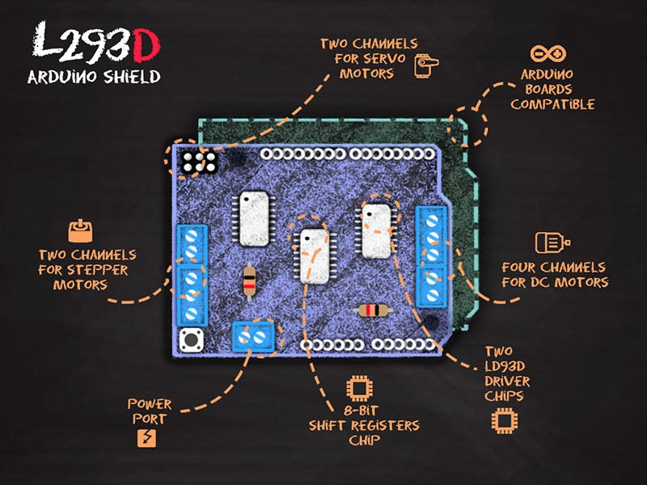
Arduino L293D motor driver shield.

Slide 14
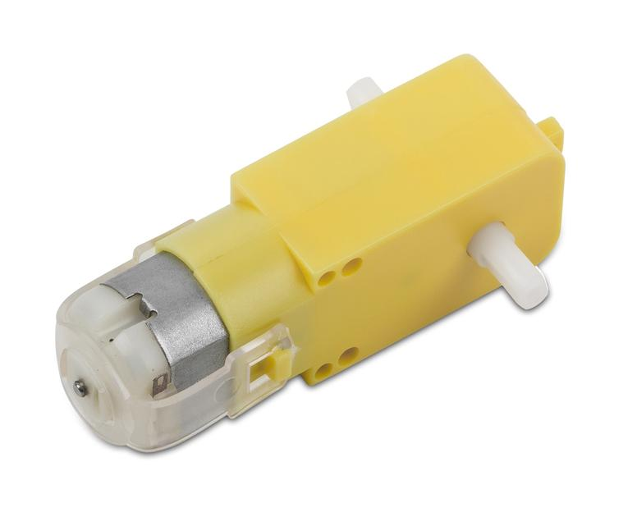
DC Motors
DC motor is the most common type of engine that can be used for many applications.
We can see it in remote control cars, robots, and etc. This motor has a simple structure.
It will start rolling by applying proper voltage to its ends and change its direction by switching voltage polarity.
DC motors speed is directly controlled by the applied voltage. When The voltage level is less than the maximum tolerable voltage, the speed would decrease.

Slide 15
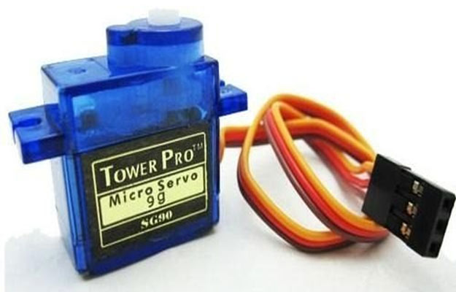
Servo Motors
Servo motor is a simple DC motor with a position control service. By using a servo you will be able to control the amount of shafts rotation and move it to a specific position.
They usually have a small dimension and are the best choice for robotic arms.

Slide 16
Software
The Arduino Integrated Development Environment - or Arduino Software (IDE) - contains a text editor for writing code, a message area, a text console, a toolbar with buttons for common functions and a series of menus.
It connects to the Arduino hardware to upload programs and communicate with them. Programs written using Arduino Software (IDE) are called sketches.
These sketches are written in the text editor and are saved with the file extension .ino. The editor has features for cutting/pasting and for searching/replacing text.
Programming Languages Used : Embedded C/C++

Slide 17
Circuit Connections

Slide 18
Working
The ultrasonic sensor is attached in front of the robot. Whenever the robot is going on the desired path the ultrasonic sensor transmits the ultrasonic waves continuously from its sensor head.
Whenever an obstacle comes ahead of it the ultrasonic waves are reflected back from an object and that information is passed to the microcontroller. The microcontroller controls the motors left, right, back, front based on ultrasonic signals. In order to control the speed of each motor pulse width modulation is used (PWM).
The obstacle avoidance robotic vehicle uses ultrasonic sensors for its movements. Arduino is used to achieve the desired operation.
The motors are connected through motor driver IC to Arduino. The ultrasonic sensor is attached in front of the robot. Whenever the robot is going on the desired path the ultrasonic sensor transmits the ultrasonic waves continuously from its sensor head. the motor.

Slide 19
Whenever an obstacle comes ahead of it the ultrasonic waves are reflected back from an object and that information is passed to the arduino.
The arduino controls the motors left, right, back, front, based on ultrasonic signals.
In order to control the speed of each motor pulse width modulation is used (PWM). When ultrasonic sensor detect the object which is kept inside the path it will send the signal toward the arduino Uno and according to that it will it will rotate

Slide 20
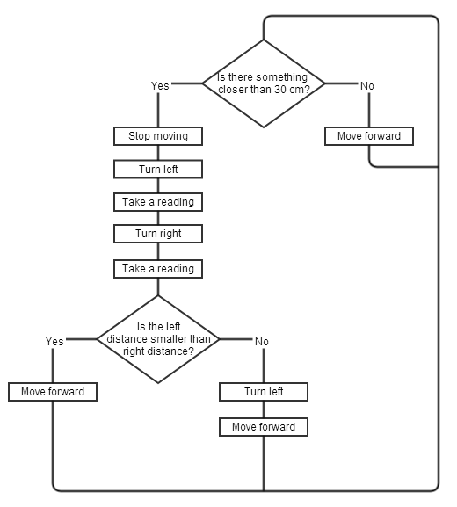
Algorithm for obstacle avoidance

Slide 21
Working Video

Slide 22
Applications
Obstacle avoiding robots can be used in almost all mobile robot navigation systems.
They can be used for household work like automatic vacuum cleaning .This logic has been specially designed for vacuum cleaner. By using heavy rating motors ,strong mechanical structure and using highly sensitive obstacle sensors, it efficiently work as vacuum cleaner
Auto parking assistance
They can also be used in dangerous environments, where human penetration could be fatal.

Slide 23
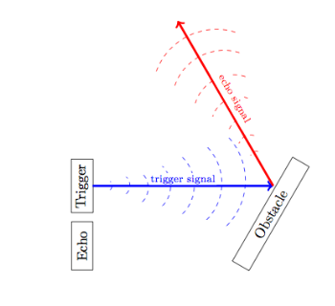
Limitations
Ultrasonic sensors such as the HC-SR04 can efficiently measure distances up to 400 cm with a slight tolerance of 3 mm. However, if a target object is positioned such that the ultrasonic signal is deflected away rather than reflected back to the ultrasonic sensor, the calculated distance can be incorrect. In some cases, the target object is so small that the reflected ultrasonic signal is insufficient for detection, and the distance cannot be measured correctly.
Furthermore, objects like fabric and carpet can absorb acoustic signals. If the signal is absorbed in the target object’s end, it cannot reflect back to the sensor, and hence, the distance cannot be measured.

Slide 24
Limitations
The intense sensitivity of ultrasonic sensors makes them efficient, but that sensitivity can also cause problems. Ultrasonic sensors can detect false signals coming from the airwaves disturbed by an air conditioning system and a pulse coming from a ceiling fan, for instance.

Slide 25
Conclusion
This project developed an obstacle avoiding robot to detect and avoid obstacles in its path. The robot is built on the Arduino platform for data processing and its software counterpart helped to communicate with the robot to send parameters for guiding movement. For obstacle detection.
The robot is fully autonomous and after the initial loading of the code, it requires no user intervention during its operation. When placed in unknown environment with obstacles, it moved while avoiding all obstacles with considerable accuracy.

Slide 26
References
https://www.microcontrollertips.com/principle-applications-limitations-ultrasonic-sensors-faq/
https://www.theengineeringprojects.com/2018/10/introduction-to-hc-sr04-ultrasonic-sensor.html#:~:text=HC%2DSR04%20is%20an%20ultrasonic,contact%20between%20sensor%20and%20object.
https://components101.com/modules/l293n-motor-driver-module

Slide 27
Thank You
Notes:
In Slide Show mode, click the arrow to enter the PowerPoint Getting Started Center.

